Slide 1


Preparing
for Morrisby Profiling
My Career Insights
for students (aged 15+) in specialist school settings
Notes:
(Slide 1) Preparing for Morrisby Profiling
The senior years of school are an exciting time, and Morrisby provides a springboard to lots of new opportunities that will quickly become available to you – subject selections, work experience, part time work, community projects, and further education.
You will be undertaking an online career discovery profile – “Morrisby” – which helps to outline your strengths, what interests you, what you are like as a person, what are you good at, and what work you might like to do in the future.
You will be asked to consider your thoughts about what you will do when you leave school and decisions you can make before then - subject choices, and possibilities for study, jobs and pathways to careers

Slide 2

WHAT is profiling?
WHY do it?
HOW to complete a profile?
WHAT happens next …
Notes:
(Slide 2) This presentation will help you to understand 4 things:
What is the Morrisby Profile
The benefits of completing a Morrisby Profile
How to complete the Morrisby Profile
What happens after you complete a Morrisby Profile
What you need to do after this session

Slide 3
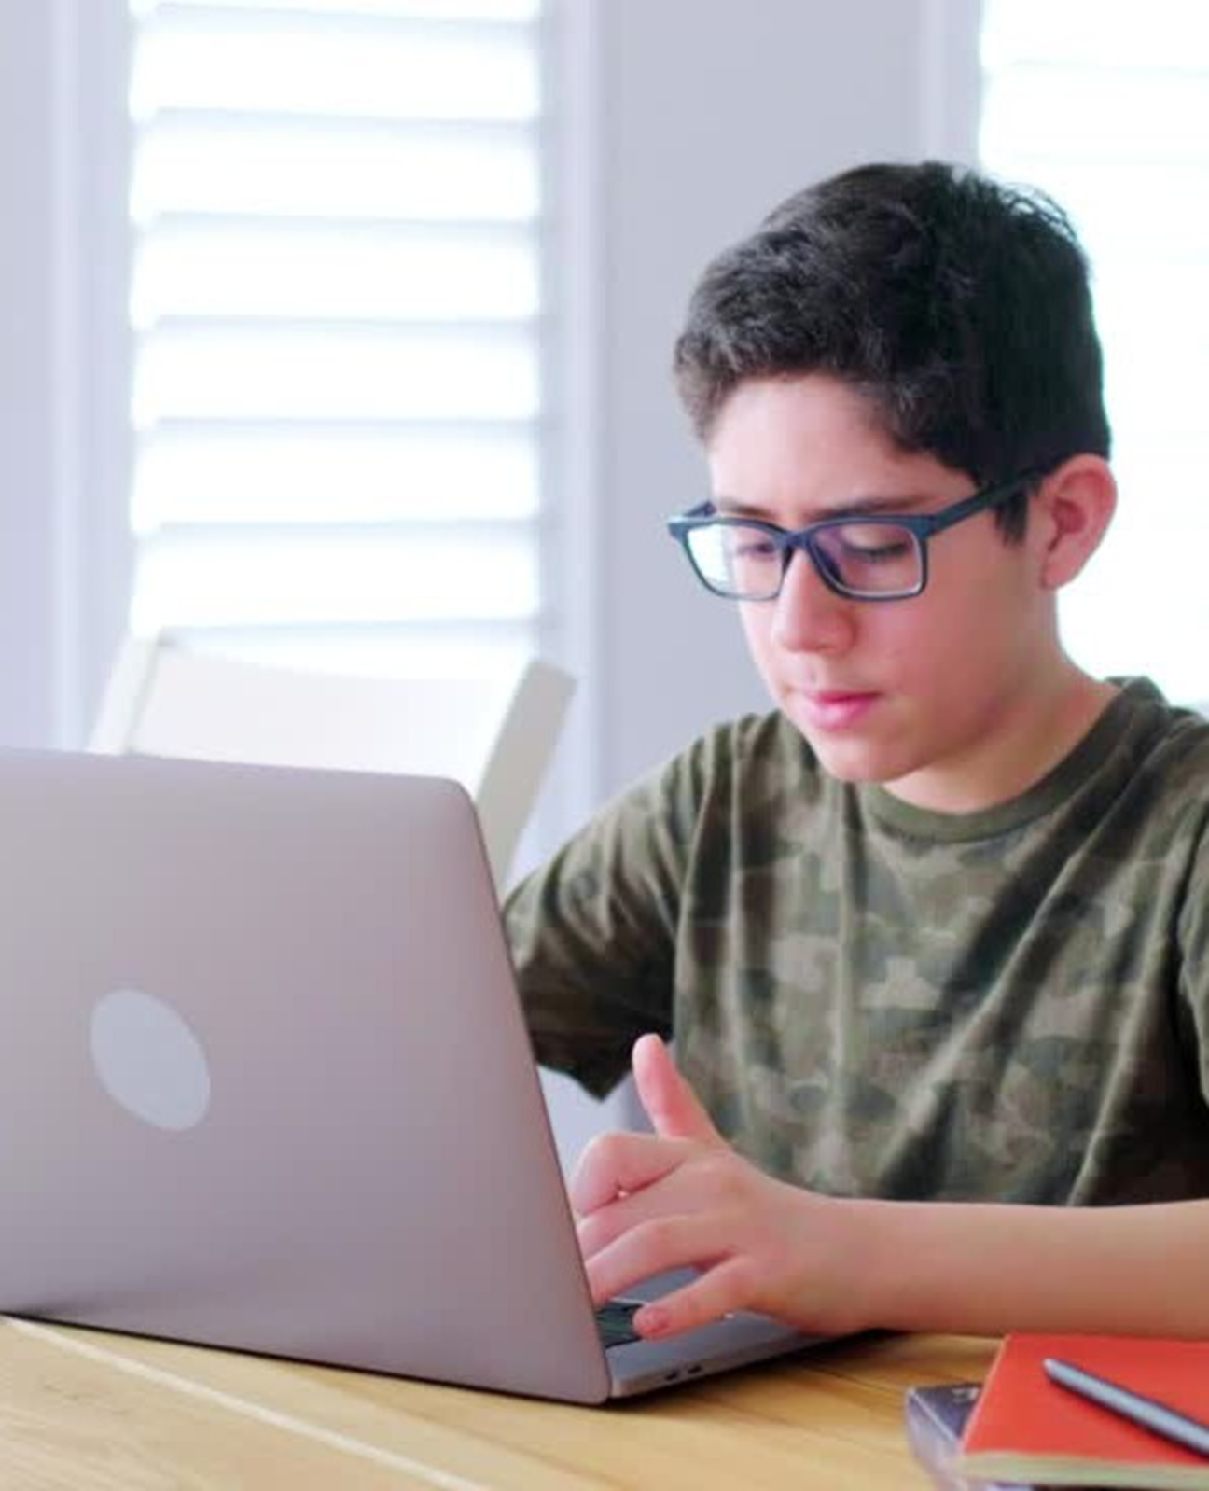

What is Morrisby Profiling?
A set of Questionnaires and Quizzes to …
LEARN more about yourself
FIND OUT about your strengths, interests, and abilities
HIGHLIGHT your talents, motivations and work preferences
Notes:
(Slide 3) What is Morrisby?
The Morrisby profile is an online career exploration tool designed to inspire and give you some guidance on your strengths, interests and abilities, and how to find career and study options that suit you
You will be guided through a series of short quizzes and questionnaires that can highlight your talents, motivations, personality, and work preferences
You will;
LEARN more about yourself
FIND OUT about your strengths, interests, and abilities
HIGHLIGHT your talents, motivations and work preferences
The profiling tool is interactive and can assist you to research further education, training, careers, and other employment options that match your strengths, interests and abilities

Slide 4

Why do Morrisby Profiling?
DECIDE what you want to do after school
RESEARCH careers, workplaces, further education and training
DISCOVER pathways to get where you want to go
Notes:
(Slide 4) Why do a Morrisby Profile? – What are the Benefits?
Deciding what you want to do after leaving school is not always easy
Firstly, you need to understand the options available to you, and then work out what you are best suited to and how to achieve your goals
This requires some thought and planning which families, teachers, and people who know you well can help with
A Morrisby profile will help you to gain insights into your skills & talents, personality and interests
You may also discover information about your best learning style, preferred style of workplace and work habits
You will be able to discover and explore career suggestions and find resources to plan future study & pathway options
There are many benefits to completing your Morrisby Profile:
DECIDE what you want to do after school
RESEARCH careers, workplaces, further education and training
DISCOVER pathways to get where you want to go
On completion of your profile, you will have the opportunity to discuss your results with a Morrisby-trained Careers Consultant or school teacher.

Slide 5

How do you complete a Morrisby Profile?
Complete a series of questions on a laptop or computer
You don’t need to ‘study’ to answer the questions
You may have teachers or learning support staff in the room to help you
Notes:
(Slide 5) How do you complete a Morrisby profile?
When is profiling scheduled for?
It is important to know that you don’t need to ‘study’ to undertake the profile but knowing what to expect will be helpful
You will need a laptop or computer or iPad
You may have teachers or learning support staff in the room to help you
You will login and complete registration on the Morrisby website https://app.morrisby.com/sign-up OR https://app.morrisby.com/login
It will take you AT LEAST 20 minutes to complete each questionnaire you choose to do. There may be around 70 questions or more in total
It is okay to take rest breaks
-> What do the questionnaires look like?

Slide 6
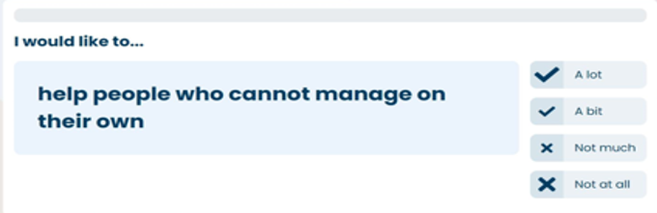
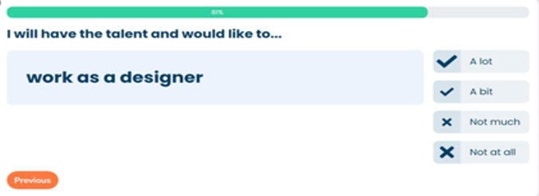

What do the questions look like?
INTERESTS
- Sample Questions
Choose ONE answer
Notes:
(Slide 6) What does the Interest quiz look like? – Sample questions
Interests quiz will ask questions to find out about things that you like or feel that you are good at. This could be something new you would like to try or skills and experience gained at school, at home and in the community eg. sports, music, cooking, looking after animals, building things
Here are some examples from the Interests quiz
After reading the question carefully, you will see 4 possible answers to choose from
Select your best answer – Choose ONE answer only for each question and click on that button
If a question seems too hard, ask a teacher to explain it to you, or decide on the closest answer and go on to the next question
If you make a mistake or change your mind, you can go back and answer the question again

Slide 7
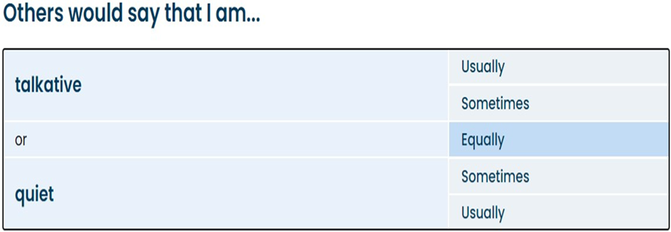
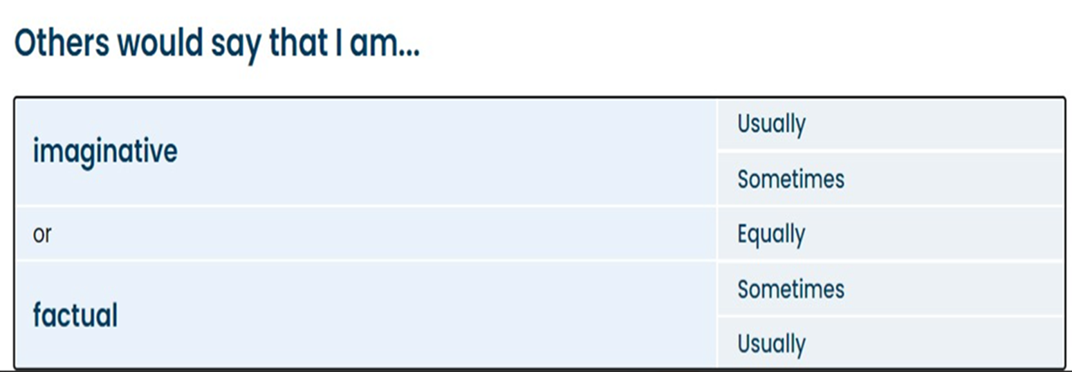
What do the questions look like?
PERSONALITY
- Sample Questions
Choose ONE answer
Notes:
(Slide 7) What does the Personality quiz look like? – Sample questions
The Personality quiz will ask questions to find out about who you are as a person –eg. are you naturally chatty or quiet, are you organised or get things done at the last minute, do you think about things in pictures or in words, are you sensitive to what others say and think about you?
Here are some examples from the Personality quiz
After reading the question carefully, you will see 5 possible answers to choose from
Select your best answer – Select ONE answer only for each question and click on that button
If a question seems too hard, ask a teacher to explain it to you, or decide on the closest answer and go on to the next question
If you make a mistake or change your mind, you can go back and answer the question again
For some students you may also want to continue with additional questionnaires and quizzes that will provide more info about your personality, study priorities and even your ‘brainpower’ – referred to as Aptitudes strengths. Talk to your teacher if this is something you want to do

Slide 8

Your Morrisby profile is all about YOU!
It is important to be honest and try your best with each question so that you receive a profile that truly shows your strengths, abilities and interests
This is not an exam - there is no pass or fail
If you need to leave the room during profiling, save, then log out
It is okay to ask for help to
understand a question or choose an answer
Notes:
(Slide 8) Tips for completing your profile
Try to be as honest and accurate with the answers you select so that you receive a profile that truly sounds like you
This is not an exam - there is no pass or fail
You will need to set up your computer or laptop and go to the Morrisby website. There may be some registration details you have to complete and your teacher will help with this
Close all other apps and tabs on your computer, these can be a distraction
Work through the questions without distractions, a quiet environment allows you to think about the questions
Try your best with each question. This will help to build a profile that truly represents your strengths, abilities and interests
Don’t rush or click through to finish questions quickly
If you need to leave the room during profiling, SAVE, then log out. When you return you can login and recommence from where you left off
Your Morrisby profile is all about YOU!

Slide 9

What happens after you complete the Morrisby Profile?
Notes:
(Slide 9) What happens after you complete the Morrisby profile?

Slide 10
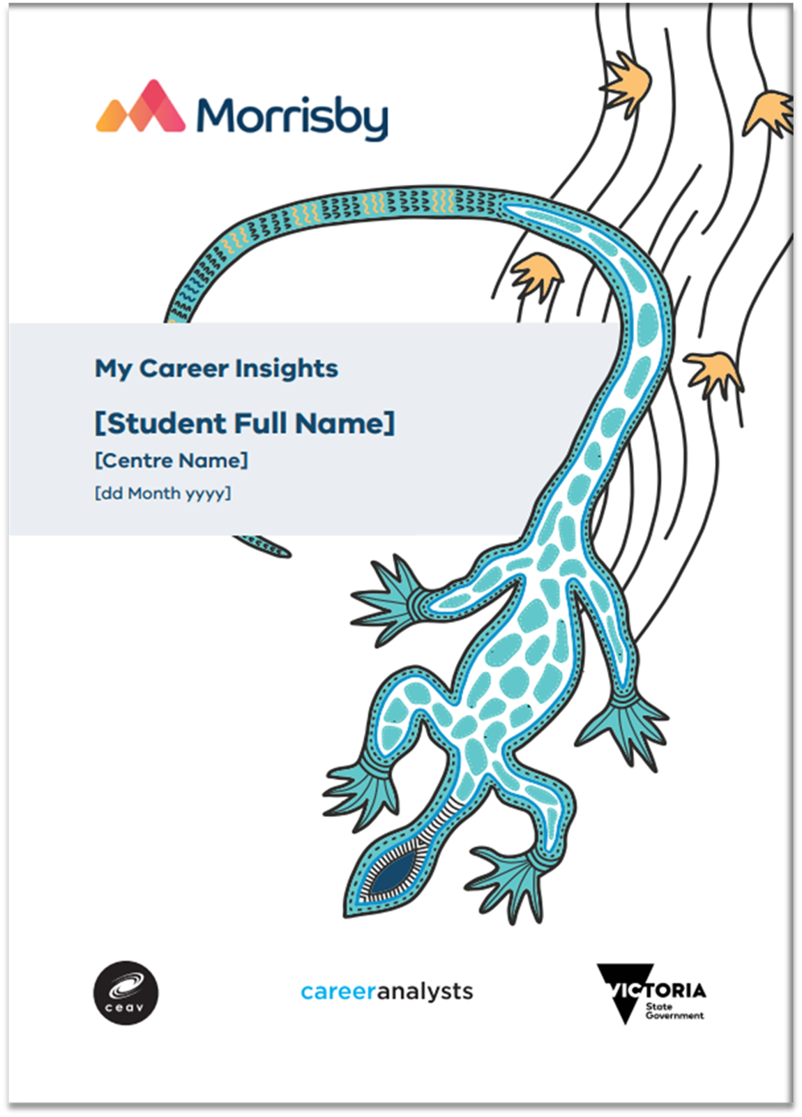
Your Morrisby Profile
Your personal and unique results can be seen in an online report which can also be downloaded and printed
Morrisby is also an interactive profile where you can explore and customize the information in it
Your profile report is all about YOU!
Notes:
(Slide 10) Your Morrisby Profile
After you have finished the Morrisby profiling your personal and unique results can be accessed in an online report
This report can also be downloaded and printed
Morrisby is also an interactive platform where you can explore and customize the information in it

Slide 11
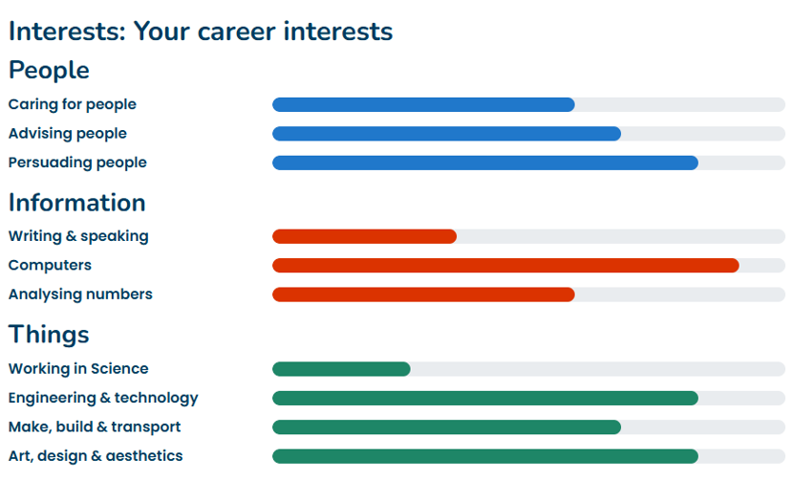
What will the results look like?
You will see some pictures, charts and graphs showing your favourite interests, and other info which could include your personality and preferred work styles
Notes:
(Slide 11) What will the results look like?
Inside the report you will find information about your results including some visual graphs and charts
Responses to the Interests questions are summarised in bar graphs categorised into ‘People’, ‘Information’ and ‘Things’
You will be able to use a Retake button anytime you feel results are no longer an accurate reflection of your interests or you have changed your thinking about what appeals to you – talk to your teacher if you can’t find it

Slide 12
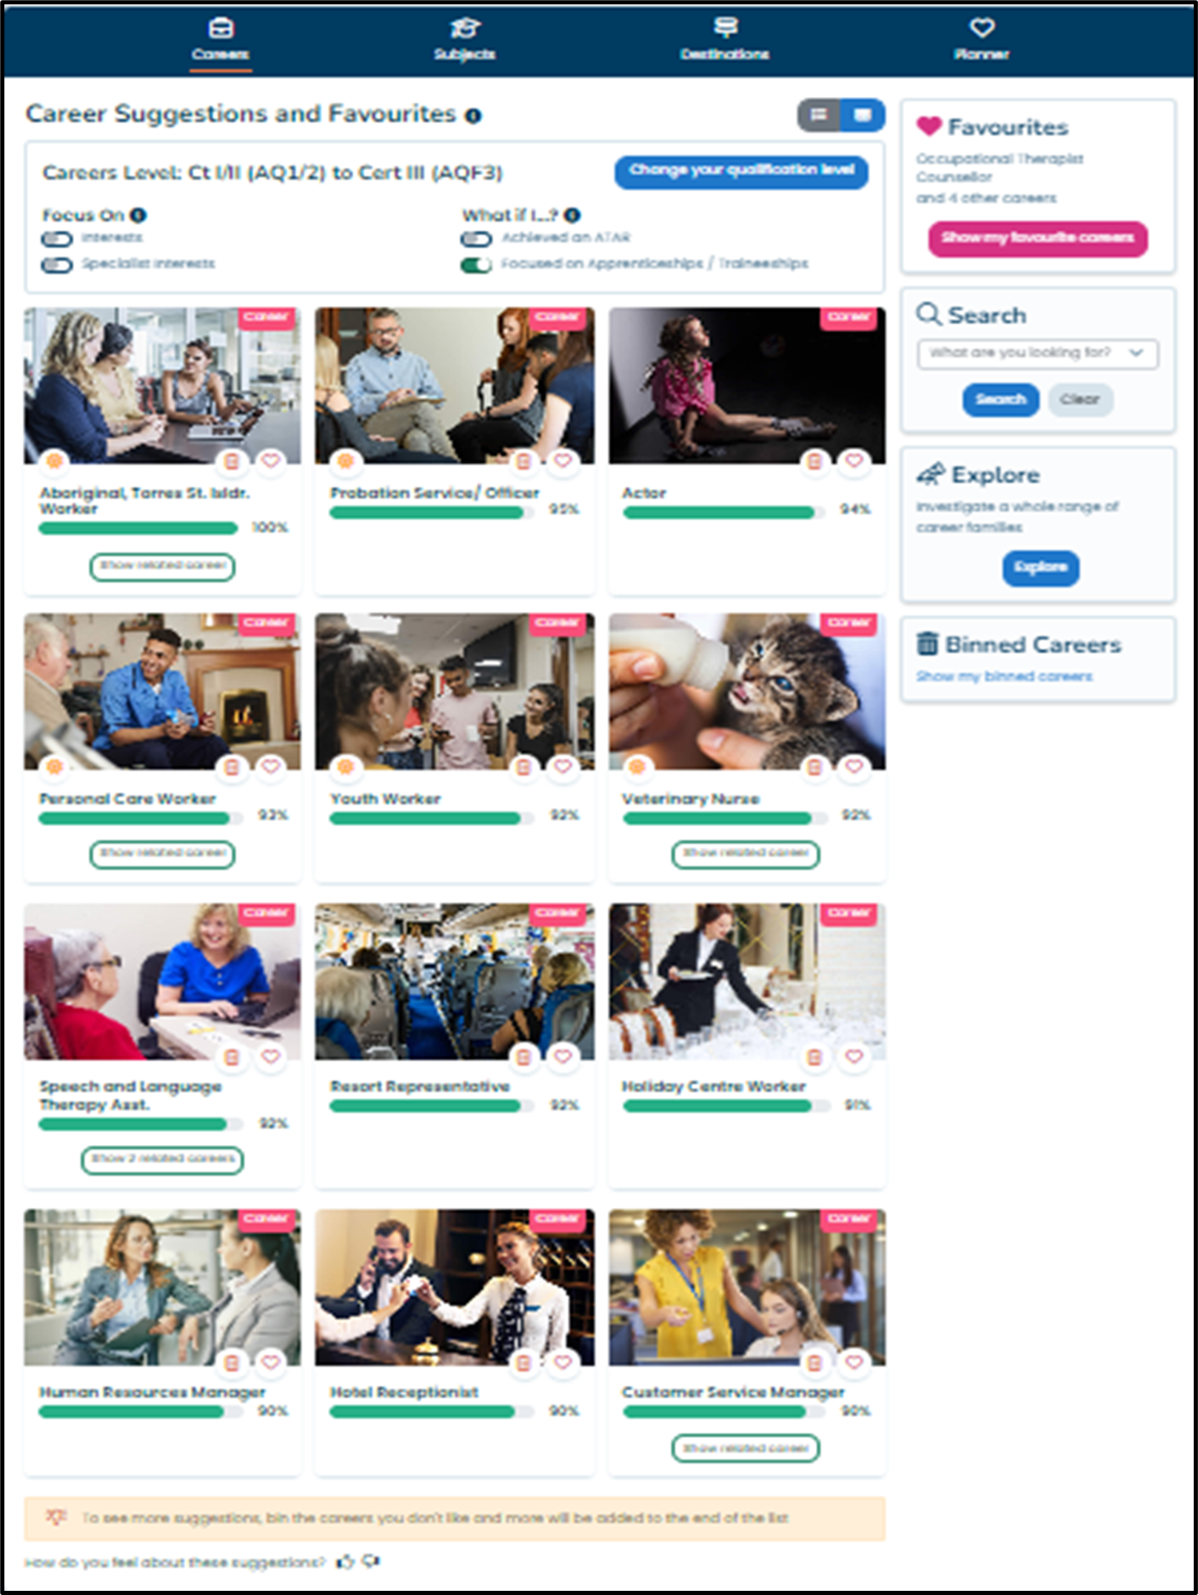
What will the results look like?
You will also see some suggestions and recommendations for career and subject selections that you could be suited to
Notes:
(Slide 12) What will the results look like?
You will also see some suggestions and recommendations for career and subject selections that may suit you.
You will be able to explore and create favourite careers and subjects that appeal to you
Other features of the profile will be shown to you by a teacher or career consultant for further exploration; including a ‘World of Work’ diagram, a workstyle chart , and resources for additional research of careers and pathway options

Slide 13
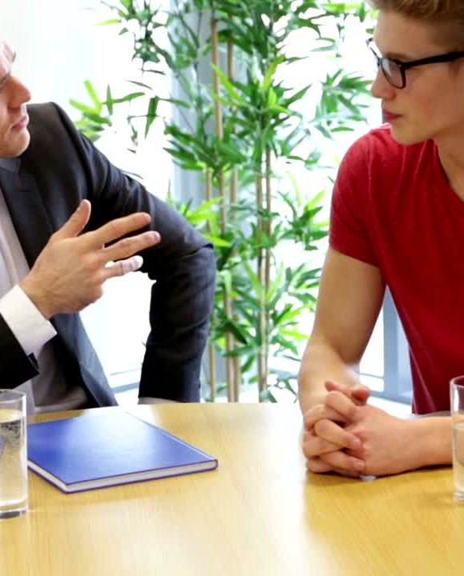
The Morrisby Unpacking Conversation
You will be offered a 30-minute conversation with a Morrisby-trained Careers Consultant or school teacher;
Discuss results
Explore features in your online profile
See how to make changes on the interactive platform
Add new information not captured by the profiling
Notes:
(Slide 13) The Morrisby Unpacking Conversation
Once you have completed your Morrisby profiling, you will be offered the opportunity to participate in a 30-minute conversation with a Morrisby-trained career consultant from outside of your school, or a teacher from within your school so that you can;
As well as looking at the results, extra features of the interactive platform will be shown to you.
This conversation will allow time for you to talk about any special interests or preferences, and look at how to make changes to your profile
Parents and learning supporters may be invited to join this conversation

Slide 14

Review
Morrisby is a career exploration tool that helps you to identify your strengths, interests, abilities, and thoughts about future work and career pathways.
Make sure you return parent/guardian CONSENT prior to profiling
You will answer questions about things you like to do, activities and subjects you might already be good at, and what you are like as a person.
You will have a follow-up conversation to understand your Morrisby profile and results
1
2
3
4
Notes:
(Slide 14) Review
1. Morrisby is a career exploration tool that helps you to identify your strengths, interests, abilities and aspirations (thoughts about future work and career pathways)
2. It is very important for you to return parent / guardian consent as soon as possible to be allowed to participate in this program
Your teachers will give you a form or let you know how to gain consent which must be returned to the school
3. Morrisby profiling contains a set of questionnaires and quizzes that ask you about your interests, things that you might already be good at, and what you are like as a person
Your Morrisby profile is all about you! Try your best to answer the questions honestly, don’t rush and avoid distractions by shutting down all tabs or apps on your computer. It will be worth the effort!
4. You will be invited to participate in a 30-minute career conversation to assist you in understanding your results and demonstrate interactive features
After you participate in your interview you will be invited to complete a survey - please look for the link to the survey in your email.
NOTE: You will be told by teachers when your profiling and interview dates will be
Access online profile (life-long) by logging back into the Morrisby website
Explore results, look at career suggestions, print / share digital report with others
Add profile to your school Career Action Plan

Slide 15


Thank you for your participation. Good luck on your career journey!
Notes:
(Slide 15) The My Career Insights Journey
Enjoy your self-discovery journey!

Slide 16

Don’t just take it from us - have a look at what other students say about Morrisby!
Notes:
(Slide 16 – HIDDEN / OPTIONAL) Student feedback on the Morrisby program
Morrisby is a popular careers program in more than 450 Victorian schools and is suited to most students in both mainstream and in specialist settings (for students that are aged 15+).

Slide 17






This was a very good experience and helped me look into the future and find my interest's and stronger strengths!
The Morrisby experience improved my understanding of my coming years of study, and the suitable course of action based on my performance in the tests and interests.
I absolutely adored my results! I couldn’t stop going through the Morrisby website trying to look for my future pathways. I enjoyed the whole interview talking about my interests and what this website can do.
My Morrisby experience was phenomenal, my Adviser was amazing and didn't leave any details out. I could clearly understand what they were saying and got a good idea moving forward
Thank you for this opportunity, it was extremely constructive and great to get an in depth overlook of my strengths and weaknesses. The Morrisby experience has helped to provide me with clarity and a deeper understanding of the careers I would be best suited for.
Thanks again
I loved it!! I’m a very indecisive person when it comes to my future and career,
so this test and overall experience was super helpful
Notes:
(Slide 17 – HIDDEN / OPTIONAL) Let’s look at what some other students have to say about Morrisby
Read comments / Allow time for students to read

Slide 18

Notes:
(Slide 18 – HIDDEN / OPTIONAL)
Additional notes eg.
Profiling dates
Interview dates
Consent forms – where to find them who to return them to

