Slide 1
Supporting MCI Consultants working with students with anxiety and disability
9 February 2022

Slide 2
Introduction: Disability and Mental Health
Autism Spectrum Disorder | Anxiety | ADHD Primary Hyperactive Impulsive | Hyperlexia | Obsessive Compulsive Disorder
Depression | Tourette’s Syndrome | ADHD Primary Inattentive | Synesthesia | Borderline Personality Disorder
SLDs Dyslexia, Dysgraphia, Dyscalculia | Dyspraxia | Epilepsy | ADHD | ADHD combined presentation
Down Syndrome | PTSD | Bipolar Disorder | Schizophrenia | Traumatic Brain Injury
Notes:
There are a wide range of diverse barriers that can impact students.
People are generally categorised according to a specific disability category which groups people with common characteristics: Autism, Deaf-blindness, Developmental delay, Emotional disturbance, Hearing impairments including deafness, Intellectual disability, Multiple disabilities, Orthopedic impairments, Other health impairments, Specific learning disabilities, Speech or language impairments, Traumatic brain injury, Visual impairments including blindness.
Students with specific learning disabilities usually have a disorder in one or more psychological processes involved in understanding or using spoken or written language. This results in imperfect ability to listen, think, read, write, spell, and/or to perform mathematical calculations.
Students with mild intellectual disability who have global deficits in the areas of memory and attention and students with SLDs can have a difficulty in a specific area or areas of cognitive functioning. These psychological processing deficits include deficits in perception, attention, memory, meta cognition, and organisation. They result in deficits that cause academic difficulties and result in achievement significantly below expectations given average intellectual capacity.
In addition to the impact this can have on self-esteem and self-efficacy, these students face a range of socio-cultural barriers that are built into social structures, expectations, education and processes. They are often bullied.

Slide 3
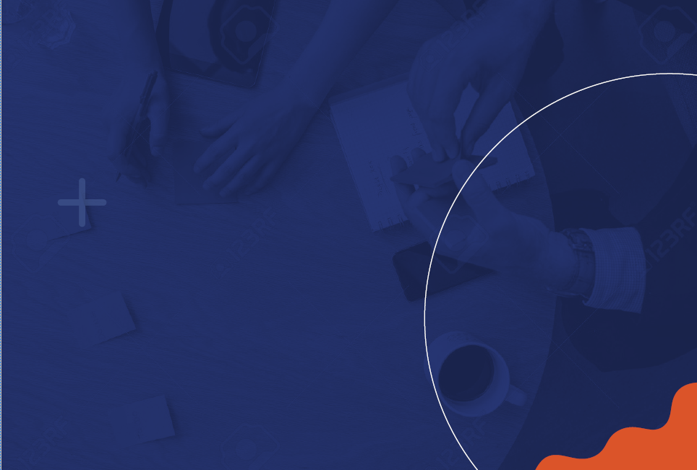
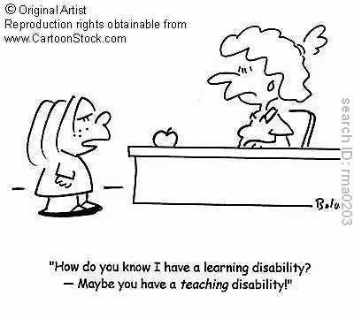
Group Exercise
Notes:
Exercise:
Turn to the person next to you and share one example of where you have seen a student, person or group not being accommodated so they can succeed or discuss as a group.

Slide 4
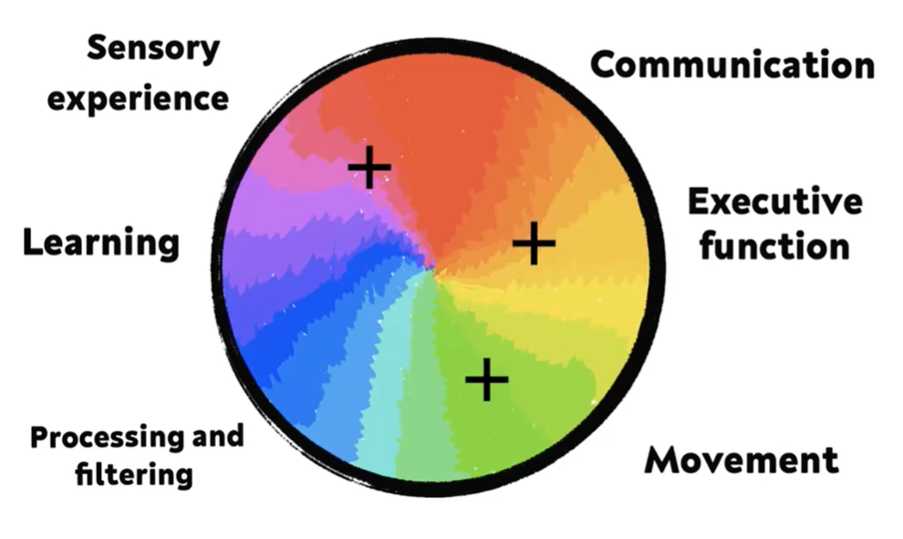
No 2 students are the same
Presentation & Communication
Notes:
This diagram highlights key areas that are impacted by disability and that can impact the presentations and communications of students with disabilities.
A range of areas may be impacted - each student is likely to experience different impacts, and levels of impact.
Challenges for consultants working with diversity and neurodiversity is that to make something accessible it can become accessible to the provider. Communication can take longer but students may look like they are not engaging, or they may resist engaging if it becomes too hard.

Slide 5
Group/Paired Exercise
Stretching ourselves
Notes:
In pairs, tell the person next to you about your weekend without using the letter R.
Presenter explores:
What did you notice - was difficult – was easier?
Conversations are less specific
Didn’t have a big enough vocab to engage without using R
Have to really focus and think about the words
Sticking to one sentence
Splitting attention – like having to communicate in a foreign language
Looking up and off to the left or right to find the words
Communication is not always straightforward
Did is seem more back and forth?
We can see differences in the body when communicating for example, with dyspraxia. Moving back and forth trying to find the words.
Was there an R police person in the group?
Communication can make it hard for consultants working out what students are saying or going to say. For students needing to think about what we are going to say uses a lot of energy. There can be les reciprocity – going back and forth or fewer follow up questions from the students. It may be challenging for students to answer follow up questions.
Some students use compensatory strategies by writing it down first.
Most importantly, we will never really know what it is like for those students.

Slide 6
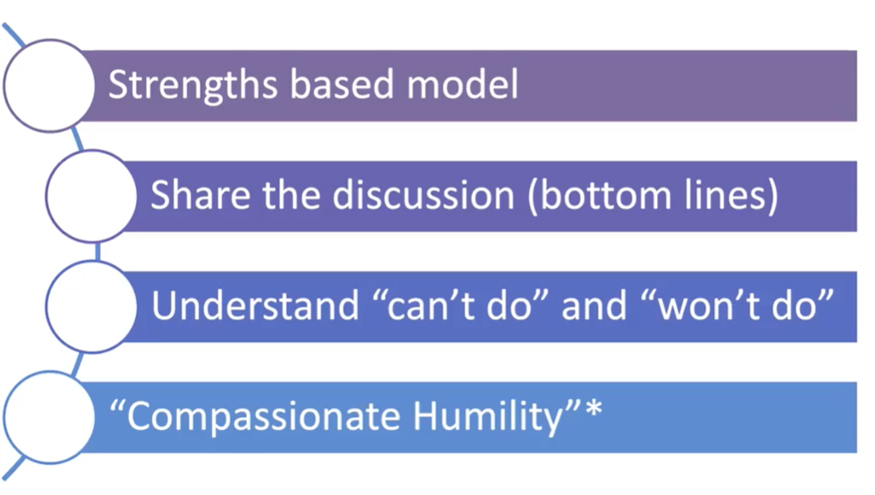
Won’t Do Can’t Do
Providing support & challenges
Notes:
Because students with disability or wellbeing issues might not be able to do something, it can present as they won’t do it, when actually they can’t do it.
It makes them look resistant to us, but they may be fearful.
They may be accustomed to not be able to do something – they may not have the right support or accommodations.
They may not have insight into their true capabilities.
Students with specific learning disabilities and other disabilities can have low self-esteem and generally a poorly defined self-concept.
Students with disability may also have a low response to engagement for other reasons. They may not want people to recognise they have a disability. They may be used to letting the more ‘powerful’ person lead. So, it is important for consultants to recognise that they may have a greater balance of power in an engagement with a student who has a disability or mental health condition.
Approaching students from a place of compassion helps both the student and the consultant and aligns to the CICA standards for supporting diversity. The way students move forward may not be what each one of us expect. Consultants play an important role in helping students identify their strengths to help them move forward.

Slide 7
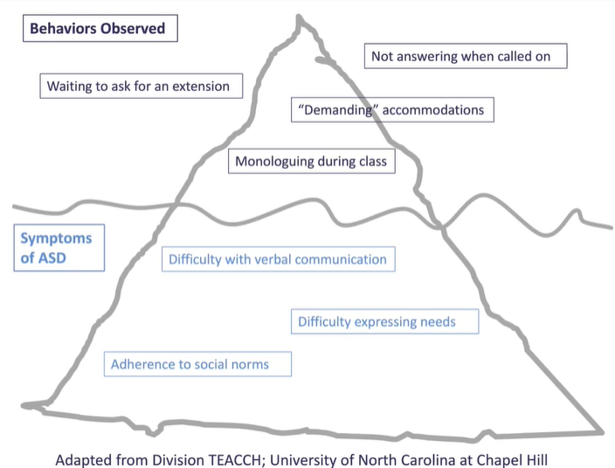
Behaviours are what we observe
These are not necessarily the underlying issues
The things we see are not always clearly linked to what we are seeing or understanding
Notes:
In this example of someone with ASD, the observable behaviours are a result of the things we cannot see. Consultants can help by trying to think about the student’s lived experience. In a short time they may not be able to know what the student’s real experience is. A student’s presentation is linked to what is happening for the student internally.
Consultants can help students feel supported by adopting a curious questioning style rather than telling – these students are often told. This can help students who appear resisting to engage more.
Examples that invite student to respond safely are:
I am curious to understand how this is for you - are you interested in pursing this but worried that you won’t be able to do it?
Is it something you would like to explore with your teachers while you are still supported at school, even though you are worried?
I can see in there results you do well/okay in this area – is this something you feel you want to pursue?
I’m not here to force you into anything, only to let you know what strengths are in your results and to support you to understand some of the options you have.
Curious questions invite a response and reduce power in the interpersonal engagement. They do not judge.

Slide 8
Anxiety
One in seven young people aged 4-17 experience a mental health condition in any given year
13.9% of children and young people met the criteria for a diagnosis of a mental disorder in the last 12 months Beyond Blue
Anxiety can be difficult to recognise in children
Many young people are not receiving treatment
Notes:
Children can experience a range of anxieties including:
Separation Anxiety
General Anxiety
Specific Phobia
Social Anxiety
The challenge for consultants working with young people is that adolescents are remodelling their brain. The brain begins to prune itself having spent many years growing like a tree. The brain begins to specialise the brain and adolescents begin to find their passion and establish circuits they will use later. While their brain is becoming more integrated, executive function declines and processing is more through the emotional centre. This can increase feelings of anxiety for anxious students who do not yet have the resources or skills to deal with this.

Slide 9
Presentation
Communication
Common signs and symptoms:
Difficulty relaxing
Muscle tension
Sleep trouble
Restlessness
Anger or irritation
Persistent and disruptive worry or fear
Trouble concentrating
Racing heart
Dizziness Fast breathing
Upset stomach
Avoiding places or situations that provoke fear
Selective mutism
Rapid speech
Reluctant to speak
Looking away/down
Not engaging
Shouting
Fidgeting
Making excuses to leave
Notes:
Anxious teens may not have the communications skills and emotional skills to be good communicators or engage well.
Common signs and symptoms:
Difficulty relaxing
Muscle tension
Sleep trouble
Restlessness
Anger or irritation
Persistent and disruptive worry or fear
Trouble concentrating
Racing heart
Dizziness Fast breathing
Upset stomach
Avoiding places or situations that provoke fear
What you might see in communication:
Selective mutism
Rapid speech
Reluctant to speak
Looking away/down
Not engaging
Shouting
Fidgeting
Making excuses to leave

Slide 10
Providing support & challenges
Validate the student’s feelings - recognising they may not feel comfortable is okay
Be honest – tell them your role and what you will be doing to help then feel more at ease
Meet them emotionally - if they are down, being upbeat can amplify their emotions and the gap between you
Listen and acknowledge their concerns
Don’t offer solutions – our ‘righting gene’ is unhelpful
Ask questions and be curious. This can increase their sense of control and control is the antidote for anxiety
Notes:
Question:
Why do you think people don’t want to approach young people about their feelings?
Examples:
Don’t know what to say
Think it will open a can of worms and they cannot help/are not available now etc.
Consultants only need to validate the student’s emotions and express they care.
If necessary, they can express their concern for a student and refer to school help if needed. If serious, they need to report – they should know they have helped.
Sometimes adults fear that if they recognise a young person’s feelings, it will be overwhelming for the student. R U Ok and other mental health research shows that this is not the case and that positive regard and asking if U R OK does not need to be overwhelming for either party.

Slide 11
CICA Standards
Informed counselling consent is 14 to 15 years of age depending on maturity
The student is at the centre of the decision-making process
CICA identifies that the client is the expert in their life and working with diversity is part of the Professional Standards for Australian Career Development Practitioners
Notes:
The participant, in this case students, are at the centre of the decision-making process. Consultants play a vital role in supporting them to become aware of themselves and to begin making informed choices:
The following competencies are listed in the CICA Standards:
Ethical principles for career development Practitioner, Client Relationships: Equity and diversity (p 6-7)
Core Competency 3. Communication and Interpersonal Skills, 3a (p 14) and 5. Diversity and inclusions, 5a (p 16-17)
Specialised Competancy 4, Diverse clients.

Slide 12
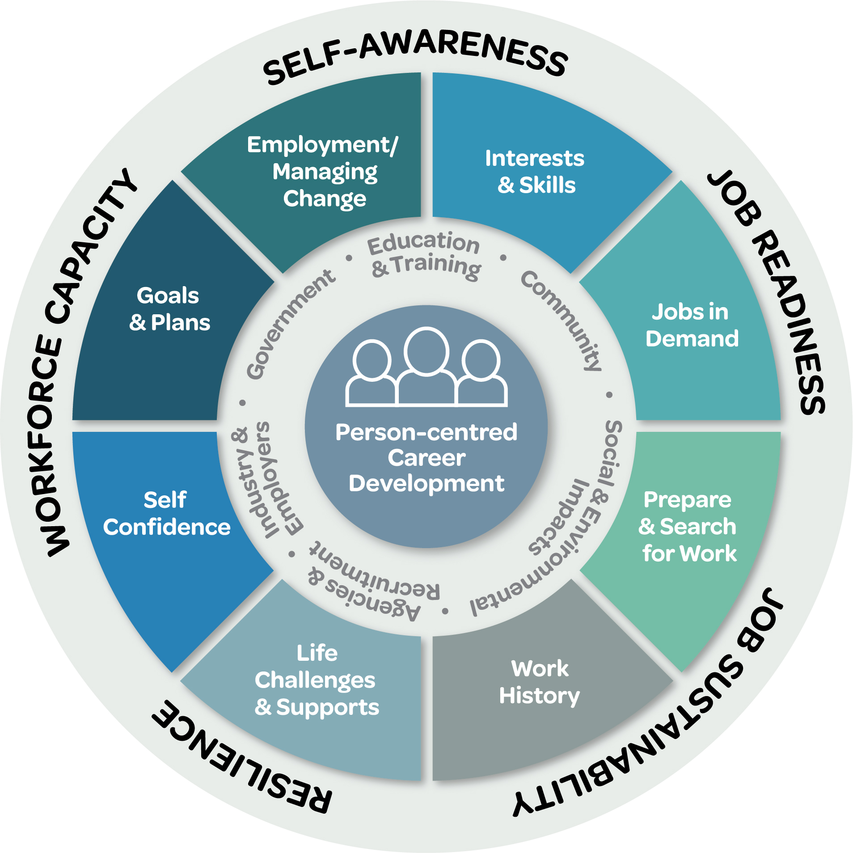
ACCE’s Career Counselling model
focuses on a person-centred career development approach

Slide 13
Tips for consultants
Clarify feelings and attitudes towards working with students with a disability
Uncertainty and feeling anxious is normal
Self compassion is important – we don’t get everything right all the time - remember you are doing good work
Sitting with discomfort and compassion are skills for professional development
Notes:
Anyone supporting children with a disability or mental health issue would benefit from clarifying their feelings and attitudes to help understand any biases so they can reflect and centre themselves with the aim of providing person-centred support.
Uncertainty and concern about performing well and knowing how to provide good support is normal and part of our ongoing development as good career counsellors and consultants.
Just as we validate issues and feelings for students and clients, Regional Coordinators can provide this same support to consultants – it is often by experience this that we learn to offer it to others.

Slide 14
Questions

